Slide 1


2022 - Introduction to R Millennium Institute for Integrative Biology - iBio
Instructors:
Jonathan Maldonado, PhD
Nate Johnson, PhD
Pablo Villarreal, PhD
Tomás Moyano, PhD

Slide 2
Calendar of the course
Dia | Fecha |  | Hora | Content | Obligatorio
Viernes | 22 | Abril | 11:00 | Q&A Section 1&2: R Basics | Required
Viernes | 29 | Abril | 11:00 | Q&A Section 3&4: R Basics
Viernes | 6 | Mayo | 11:00 | Q&A Section 1&2&3: R Visualization
Viernes | 13 | Mayo | 11:00 | Q&A Section 4&5: R Visualization & R Markdown
Viernes | 20 | Mayo | 11:00 | Tarea 1 (due at 10:00am) | Required
Viernes | 27 | Mayo | 11:00 | Q&A Section1: RNAseq Data Preprocessing | Required
Viernes | 3 | Junio | 11:00 | Q&A Section2: Temporal analysis of RNA-seq data | Required?
Viernes | 10 | Junio | 11:00 | Q&A Section3: Treatment_and_Multivariables | Required?
Viernes | 17 | Junio | 11:00 | Q&A Section4: Transcriptional Networks | Required?
Viernes | 24 | Junio | 11:00 | Tarea 2 | Required
EDX
Nate Johnson
Jonathan Maldonado
Pablo Villarreal
Tomás Moyano
Same zoom link every time.
https://us06web.zoom.us/j/89928261989?pwd=K2RiZnhBN01jUGhVbHRncmtZdndYQT09
https://github.com/ibioChile/Transcriptomics-R-Workshop-public

Slide 3
Strategies for solving problems
To program is to know how ”to google”
Google
How to google? Reserved characters (“”)
Stack Exchange
BioStars (for bioinformatics problems).
Advice from others… Usually useful, but maybe avoidable with a little googling.
Write me at nathan.johnson@mayor.cl or jax523@gmail.com.
Questions and answers session.
When you get good at R, you can understand your data much better!

Slide 4
Tips
Include a object type in the name of a variable! E.g. expression.df heights.vec categories.ls
Use descriptive variable names: abundance.df is much better than a.df (or worse ”a”).
You can use shorter names for a small section if you copy the object: a.df <- abundance.df
Use section dividers to clarify the sections of your script. (ctrl-shift-R windows, cmd-shift-R mac)
Do not use the terminal! Write everything in scripts and run from there. You will need to rerun code. This is your only record of what you did.
Use functions to organize your code - you can “wrap” discrete pieces of a script into a basic function.
The “#” character indicates comments – anything following this will not be evaluated. Tip: you can comment entire lines in R studio with (ctrl-shift-C windows, cmd-shift-C mac).
I will add more as we continue through the course

Slide 5
Questions and Answers
Here, I can help any problems, confusion, questions, concerns – any other problems with the course material.
Share your difficulties! We can help others who are struggling!
Use the “raise hand” command, the chat, or speak up.

Slide 6
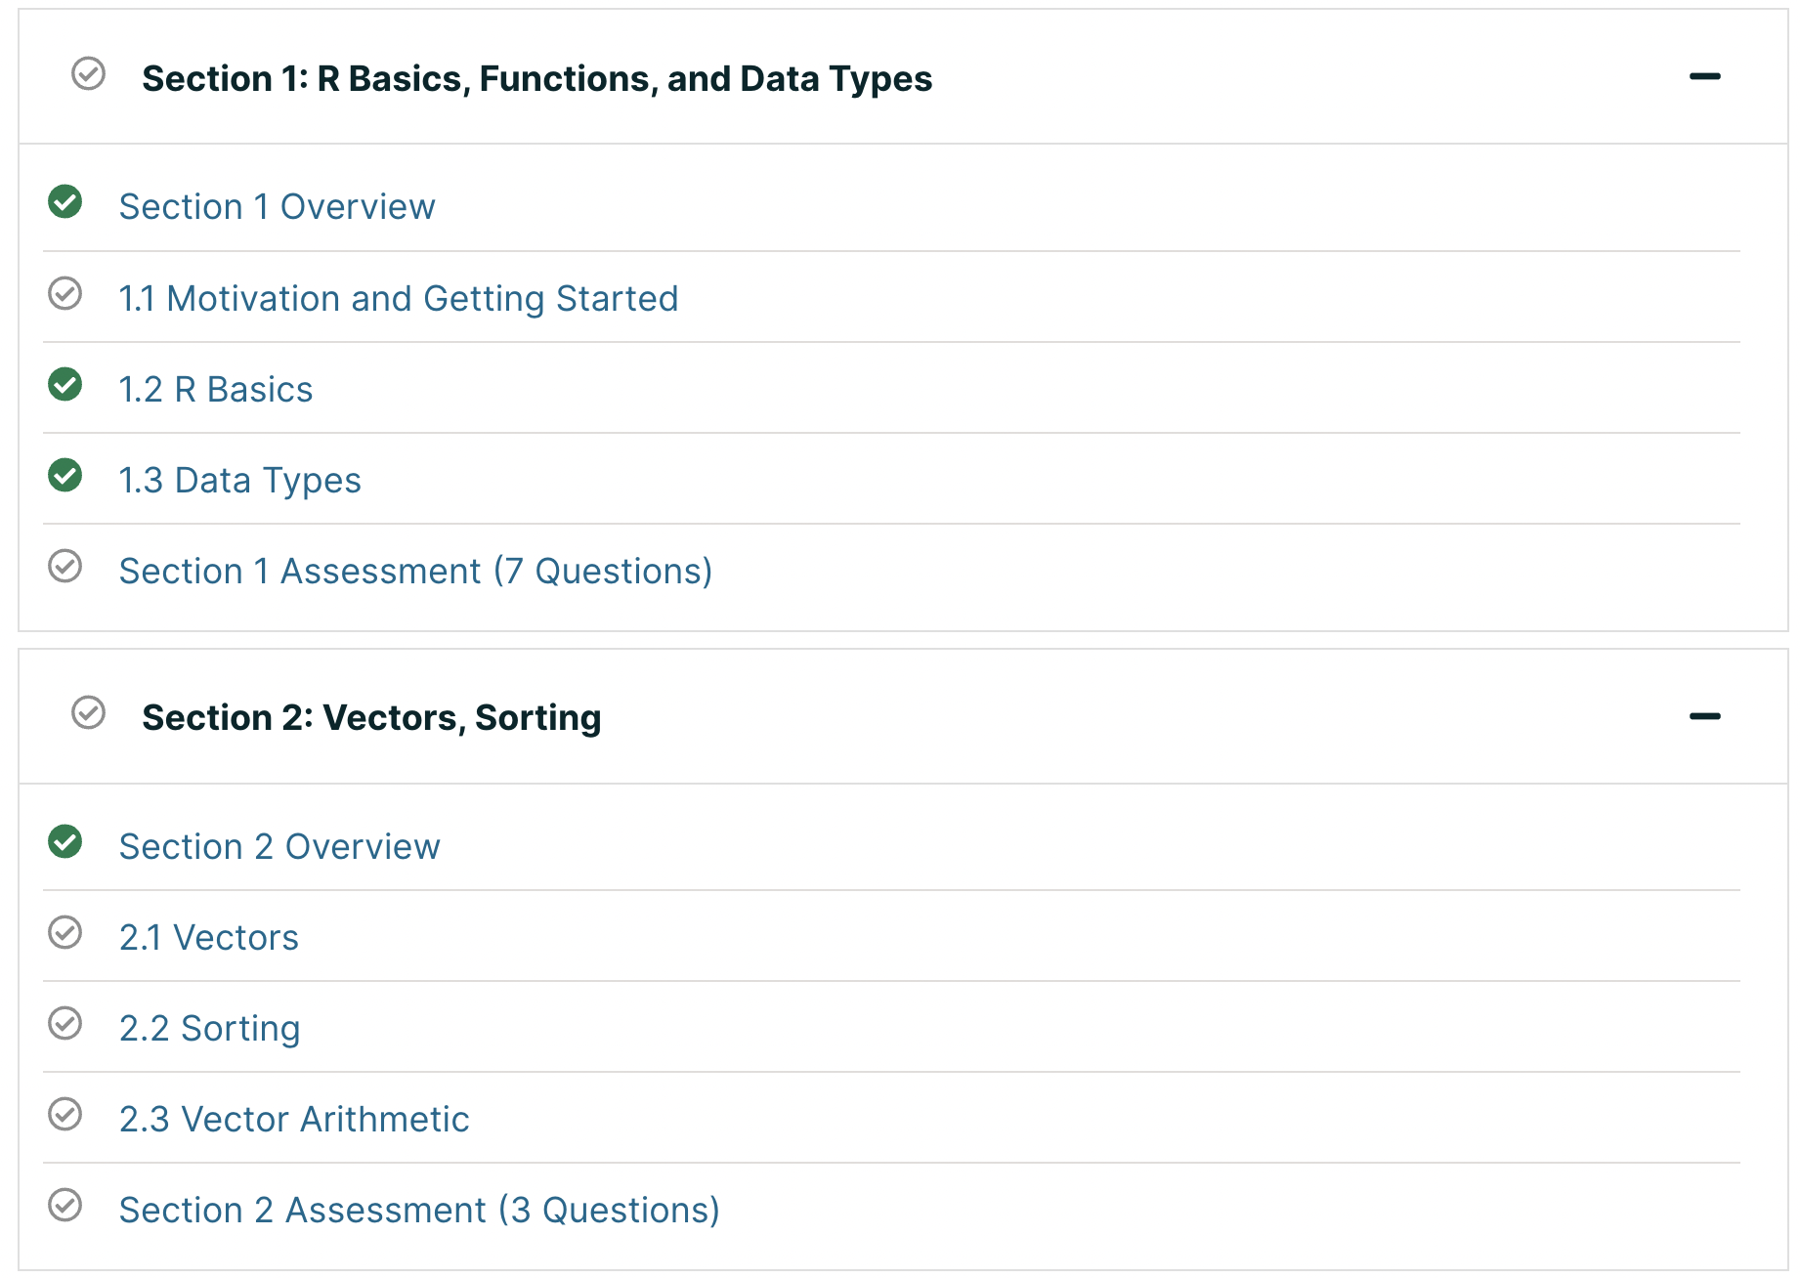
Week 1

Slide 7
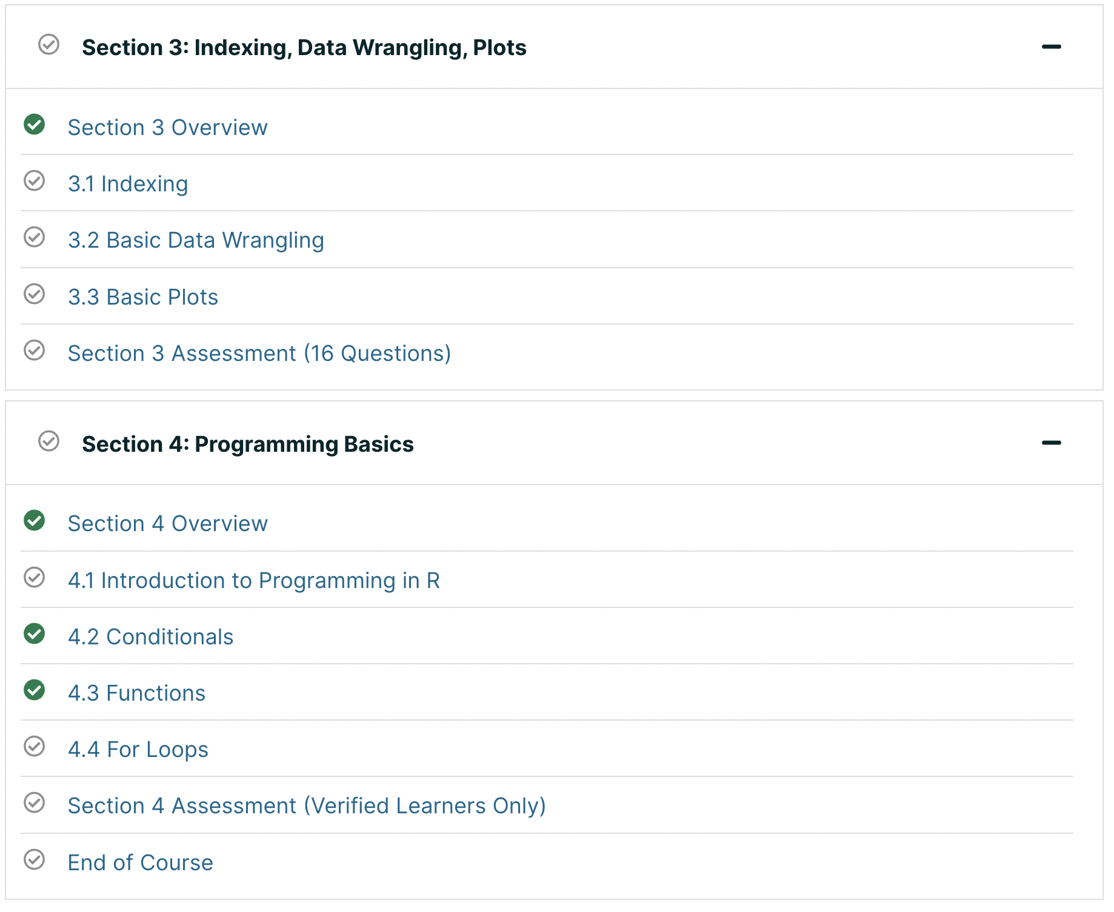
Week 2

Slide 8
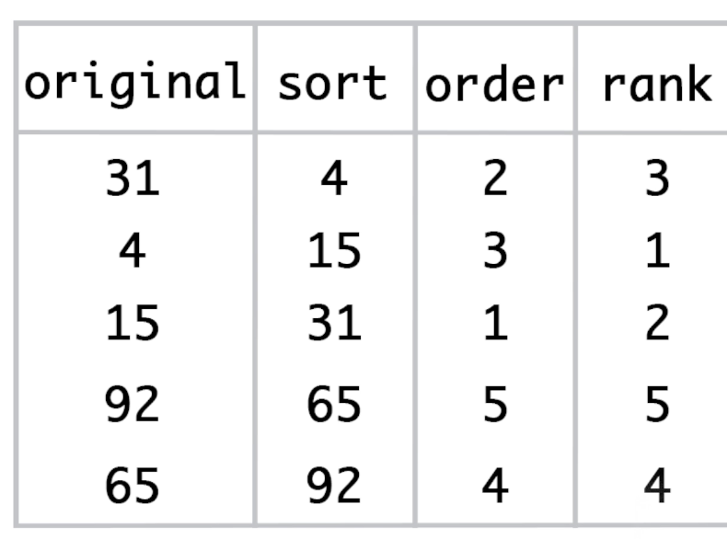
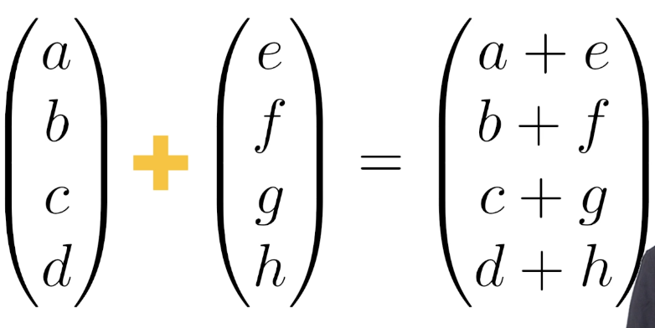
Vector arithmetic
Sorting/ordering functions

Slide 9
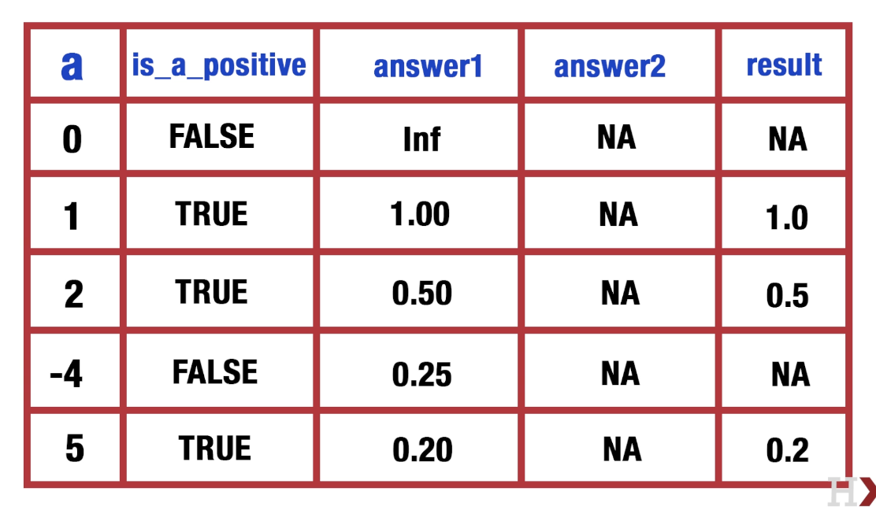

Slide 10
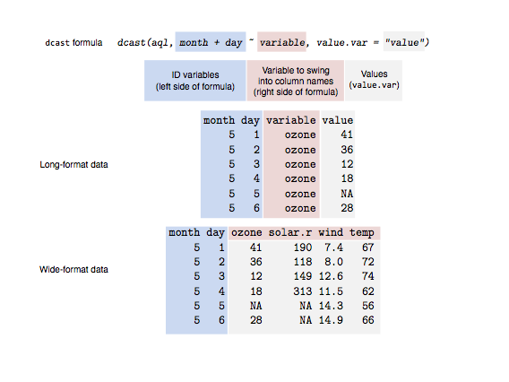
Data shape
reshape2 package
melt() Wide to Long
dcast() Long to Wide
aggregate() Long to wide (with aggregation)

Slide 11
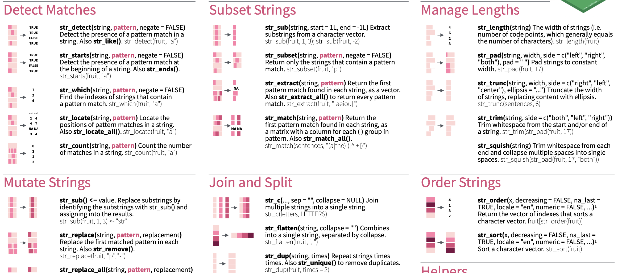
String manipulation
stringr package

